Slide 1
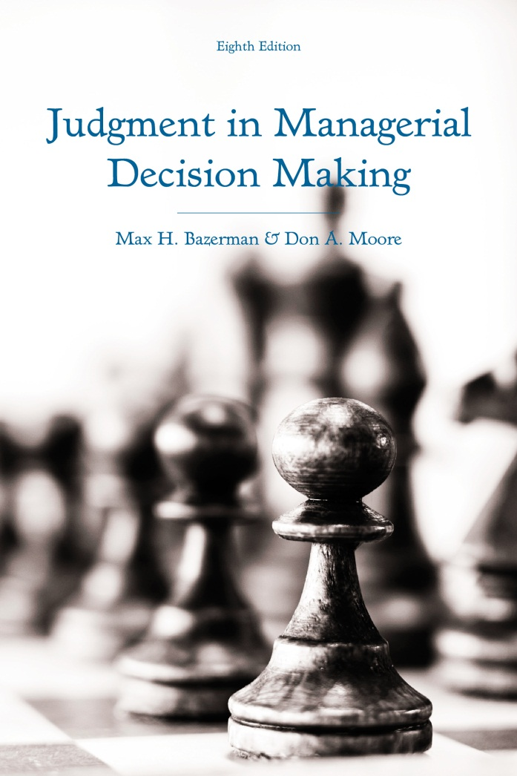
Judgment in Managerial Decision Making 8e
Chapter 1
Introduction to Managerial Decision Making
Copyright 2013 John Wiley & Sons
Notes:
The human mind can accomplish some remarkable things.
However, because our minds are so complex, we often fail to recognize when it can fail to make quality decisions.
Psychological research has uncovered many shortcuts that we use to make decisions and has identified the situations in which these shortcuts are the most likely to fail us.
Even the most intelligent of people are susceptible to being misled by these mental shortcuts.

Slide 2
The Anatomy of Decisions
Judgments involve cognition.
Common decision situations:
  How to select a post-MBA job?
  Who to hire for your company?
  What startups should you fund?
  Which firm to acquire?
What do these scenarios have in common?
Notes:
The term judgment refers to the cognitive aspects of our decision-making process.
Examples of decisions:
You are ﬁnishing your MBA at a well-known school. Your credentials are quite good, and you expect to obtain job offers from a number of consulting ﬁrms. How are you going to select the right job?
You are the director of the marketing division of a rapidly expanding consumer company. You need to hire a product manager for a new “secret” product that the company plans to introduce to the market in ﬁfteen months. How will you go about hiring the appropriate individual?
As the owner of a venture capital ﬁrm, you have a number of proposals that meet your preliminary considerations but only a limited budget with which to fund new projects. Which projects will you fund?
You are on the corporate acquisition staff of a large conglomerate that is interested in acquiring a small-to-moderate-sized ﬁrm in the oil industry. What ﬁrm, if any, will you advise the company to acquire?
These scenarios share the following in common:
Each proposes a problem.
Each has a number of alternative solutions.

Slide 3
Six Steps to Rational Decisions
Define the problem
Identify the criteria
Weight the criteria
Generate alternatives
Rate each alternative on each criterion
Compute the optimal decision
Notes:
There are six steps that you should take to making rational decisions:
Define the problem
Without a well-specified problem, you put yourself at risk of solving the wrong problem.
Common failures to define the problem:
Defining the problem in terms of a proposed solution
Missing a larger, more important problem
Diagnosing the problem in terms of its symptoms
Identify the criteria
Most decisions require you to make tradeoffs on different objectives
Rational decision makers identify all of the relevant objectives and criteria in the decision-making process
Weight the criteria
Rational decision makers must weight the value of each criteria
This typically requires making some sort of conversion where you score the importance of each criteria on a quantifiable scale.
Generate alternatives
Rational decision makers identify multiple potential courses of action.
However, many of them invest more costs into searching for potential alternative courses of action than are justified.
Rate each alternative on each criterion
Compute the anticipated costs and benefits associated with each potential course of action
Rational decision makers focus on the consequences that are relevant to each criteria
Compute the optimal decision
1) Multiply the expected benefit of each alternative course of action with respect to each criterion by the importance weight of each criterion.
2) For each alternative course of action, add all of the weighted benefits associated with each criterion together.
3) Choose the option with the highest weighted benefit.
Unfortunately, we often fail to apply these six steps in an optimal fashion.

Slide 4
System 1 and System 2 Thinking
System 1 Thinking
System 2 Thinking
Intuitive
Fast
Automatic
Effortless
Implicit
Emotional
Slow
Conscious
Effortful
Explicit
Logical
Notes:
We tend to think in two ways, which are referred to as System 1 and System thinking.
System 1 thinking is:
Intuitive
Fast
Automatic
Effortless
Implicit
Emotional
System 2 thinking is:
Slow
Conscious
Effortful
Explicit
Logical
Often, System 1 thinking can do the trick, but for important decisions, we should ideally rely on System 2 thinking.

Slide 5
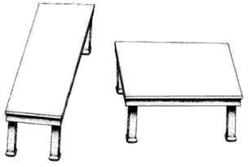
Which Table is Longer?
Notes:
The table to the left looks longer and skinner than the table to the right.
However, this is an illusion: both tables are the same length and width.
If using System 1 thought, you would probably take a quick look and give in to the illusion.
However, if using System 2 thought, you would trace one of the tables and position over the other table to find that they are both the same dimensions.
We are much more likely to make judgment errors when relying on System 1 thought.
Ideally, we would use both systems of thought in tandem, but sometimes our System 2 thought fails to correct our faulty System 1 intuitions.

Slide 6
The Bounds of Human Attention and Rationality
Prescriptive vs. descriptive models
We are satisficers, not maximizers
We use heuristics
We discount the future
We care about others’ outcomes
Bounded awareness
Bounded ethicality
Notes:
Rationality refers to decision-making processes that yield the optimal solution.
However, we often fail to achieve optimal outcomes.
In order to reconcile the discrepancy between what we should do and what we actually do, we need prescriptiv e and descriptive models.
Prescriptive models tell us what we should do to achieve economically optimal outcomes.
Descriptive models tell us what we actually do, irrespective of whether it leads to an optimal outcome.
Rather than maximizing our outcomes, we often satisfice
Our memory, attention, and computational abilities are limited
Thus, we often accept satisfactory solutions rather than optimal outcomes.
Heuristics are cognitive short-cuts that we use to make decisions.
They serve as simplifying strategies and rules of thumb to make quick decisions.
While they facilitate the process of making decisions, in some cases, they are misleading.\
We have limited willpower and as a result, we often weight the importance of the present much than the importance of the future.
We also care about the outcomes of others, which often prevents us from maximizing our own outcomes.
We are not always aware of obvious and readily available information
We also display inconsistent ethical behavior in ways that we are unaware of

Slide 7
You are looking to hire a marketing MBA student for your company. You decide to limit your search to new MBA’s from the top six management schools.
Notes:
This is an example of a heuristic.
The heuristic is sub-optimal because it does not consider all possible hires.
However, it could be argued that using this heuristic limits search costs to such an extent that it justifies making a decision that is marginally less than optimal.
In most circumstances, the heuristic is likely to yield quality decisions.
However, when heuristics like this are applied inappropriately, they can lead us astray.
Other examples of heuristics:
“Never play for an inside straight.” (Poker player)
“Spend 35% of your income on housing.” (Mortgage banker)

Slide 8
Four General Heuristics
Availability heuristic
Representativeness heuristic
Confirmation heuristic
Affect heuristic
Notes:
I will introduce you to four general heuristics: availability, representativeness, confirmation, and affect
Availability heuristic: assessing the frequency, probability, or likely causes of an event according to which instances are available in memory at a given point in time.
Representativeness heuristic: we judge people according to the extent to which they match up with a previously formed stereotype.
Confirmation heuristic: we look for evidence that confirms our intuitions rather than evidence that refutes it.
Affect heuristic: our emotions often guide our decision-making.

Slide 9
Availability Heuristic Examples
Worker proximity
Recent success of comparable products
Buying the stock of popular firms
Notes:
Worker proximity is one factor that may influence availability, as a subordinate located in close proximity to the manager’s office may receive more critical evaluations than a subordinate sitting down the hall since the manager is more likely to notice the errors made by the subordinate that he or she constantly sees throughout the day.
A product manager may assess the probability of a new product succeeding by recalling the recent successes and failures of similar products.
Investors are more likely to think of popular companies when buying stocks, so stock in these companies are more likely to be overvalued than stock in relatively obscure companies.
These strategies can each lead people astray when the factors that influence the availability of information are unrelated to the objective frequency of actual events occurring.

Slide 10
Representativeness Heuristic Examples
Individual characteristics and sales jobs
Startups and similarity to past ventures
Causes of disease
Notes:
One example of the representativeness heuristic is when a manager possesses a lay theory that certain types of people are better at certain jobs. For example, a manager may think that extroverts, ex-athletes, or white males are the best salesmen and use this as a basis to hire people fitting into these categories.
Venture capitalists may determine whether to invest in a new venture by comparing it to prior ventures that were either successful or unsuccessful.
It took people awhile to accept that germs are the cause of many diseases, as it was difficult for people to think that microscopic objects could cause such serious health issues.
To the extent that representative information is insufficient to make accurate judgments, the representativeness heuristic can lead to biased decision making.

Slide 11
Confirmation Heuristic Examples
Is marijuana related to delinquency?
Are couples who marry under the age of 25 more likely to have bigger families than couples who marry at an older age?
Notes:
You most likely answered the marijuana question by thinking of people who you know that smoked marijuana and considering whether or not they were delinquents. However, you should have considered all of the following:
Marijuana users who are delinquents
Marijuana users who are not delinquents
Delinquents who do not use marijuana
Non-delinquents who do not use marijuana
You most likely answered the marriage question by considering whether those who marry young are more likely to have large families than those who marry later. But, you should have considered all of the following:
Couples who married young and have large families
Couples who married young and have small families
Couples who married older and have large families
Couples who married older and have small families
We typically need to consider multiple situations to make an appropriate comparison of the base rate of people with some trait who exhibit some characteristic relative to the base rate of people with some other trait who exhibit a different characteristic.
Unfortunately, we rarely consider all the situations that are appropriate and this leads us to search for evidence that upholds our prior false conclusions, to insufficiently adjust from arbitrary starting points, and to dismiss the possibility that things could have unfolded differently than they did in reality.

Slide 12
Affect Heuristic Examples
A manager’s mood
An applicant’s similarity to an ex-spouse
The weather
Outrage at a defendant
Notes:
A manager’s mood may influence his or her decision-making. He or she may be more likely to give positive performance evaluations when in a good mood.
A person interviewing a job applicant may not view the applicant favorably if he or she is reminiscent of a painful former relationship.
Sunny weather makes people feel optimistic, which increases stock prices.
Even though juries should decide penalties according to a rational assessment of the harm caused by a defendant's action, they often allow their outrage at the defendant to dictate their sentencing recommendations.

Slide 13
Other Things to Come
Overconfidence
Framing and reversals of preference
Escalation of commitment
Common investment mistakes
Making rational decisions in negotiation
Seven strategies for improved decision-making
Notes:
Overconfidence is one of the most pervasive biases that facilitates many others.
Our preferences are often completely reversed by factors that are irrelevant to a decision.
We often escalate our commitment to a particular course of action in a manner that leads us to make a series of suboptimal decisions in succession.
Many biases lead to investors making sub-optimal investment decisions.
After reviewing how people should approach negotiations to maximize their own outcomes, I will review the mistakes that often lead to them falling short of achieving optimal outcomes.
At the conclusion of the course, I will review strategies that you can use to improve your own decision-making and reduce your susceptibility to biased decision-making.

